Slide 1
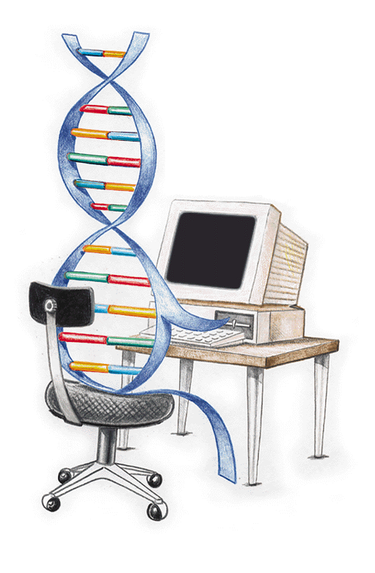
Overview of Evolutionary Algorithms:
A survey of Evolutionary Computation theory and paradigms.

Slide 2
Presentation Layout
Background information (why EA and Where to use EA)
Basic definitions and operations of evolutionary computation – what is considered an evolutionary computation method?
Specific evolutionary computation methods – what paradigms exist?
Typical example/demonstration – illustration examples
Conclusion

Slide 3
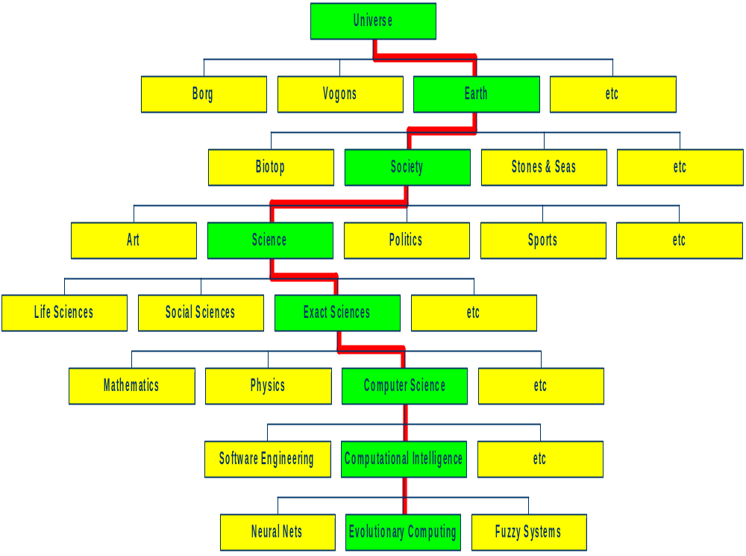
Background information – The bigger picture

Slide 4
Motivation to EC -(1)
Nature has always served as a source of inspiration for engineers and scientists
The best problem solver known in nature is:
  the (human) brain
  the evolution mechanism that created the human brain (after Darwin’s Origin of Species)
Thus has lead to research in
  Neurocomputing (connectionism)
  evolutionary computing (actionism)

Slide 5
Motivation to EC -(2)
Developing, analyzing, applying problem solving methods, termed, algorithms is a central theme in mathematics and computer science. However for most problems:
  Time for thorough problem analysis decreases
  Complexity of problems to be solved increases
See combinatorial optimization problems
A compendium of NP optimization problems
    http://www.nada.kth.se/~viggo/wwwcompendium/
So why not use common heuristic methods?
Consequence:
Robust problem solving technology needed

Slide 6
Timeline
1952: first works on stochastics optimization methods[1].
1954: Barricelli carry out the first simulations of the evolution process and use them on general optimization problems[2].
1965: Rechenberg conceives the first algorithm using evolution strategies[3].
1966: Fogel, Owens et Walsh propose evolutionary programming[4].
1970: Hastings conceives the Metropolis-Hastings algorithm, which can sample any probability density function[5].
1975: John Holland proposes the first genetic algorithms[6].
1980: Smith describes genetic programming[7].
1983: based on Hastings's work, Kirkpatrick, Gelatt and Vecchi conceive simulated annealing[8].
1985: independently, Černý proposes the same algorithm[9].
1986: first mention of the term "meta-heuristic" by Fred Glover, during the conception of tabu search[10] :
1986: Farmer, Packard and Perelson work on artificial immune systems[11].
1988: the first conference on genetic algorithms is organized at the University of Illinois at Urbana-Champaign.
1988: works on the collective behaviour of ants finds an application in artificial intelligence[12].
1988: Koza register his first patent on genetic programming[13].
1989: Goldberg publishes one of the best known books on genetic algorithms[14].
1989: Evolver, the first optimisation software using the genetic algorithm, is released by the Axcelis company.
1989: The term "memetic algorithm" is first used by Moscato[15].
1991: the ant colony algorithms are proposed by Marco Dorigo, in his Ph.D. thesis[16].
1993: The journal Evolutionary Computation begins to be published by the MIT.
1995: Feo and Resende propose the greedy randomized adaptive search procedure[17].
1995: Kennedy and Eberhart conceive particle swarm optimization[18][19].
1996: Mühlenbein and Paaß work on estimation of distribution algorithms[20].
1997: Storn and Price propose a differential evolution algorithm[21].
1997: Rubinstein works on the cross entropy method[22].
1999 : Boettcher propose the extremal optimization[23].
2000: First interactive genetic algorithms[24].
2001: Geem, Kim, and Longanathan propose harmony search[25].
2004: Nakrani and Tovey describe the honey bee algorithm[26].
2008: Yang describes the firefly algorithm[27].
2008: Karaboga and Basturk describe the Artificial Bee Colony Algorithm[28].

Slide 7
Combinatorial optimization
Methods used include
  EC methods
  Simulated annealing
  Tabu search
  Ant colony optimization e.t.c.
Our Scope
  EC methods

Slide 8
Evolutionary Computation
What is the Evolutionary Computation?
  Stochastic search (or problem solving) techniques that mimic the metaphor of natural biological evolution.
Where have they been used?
  Optimization
  Simulation and modelling

Slide 9
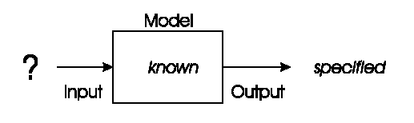
Problem type 1 : Optimisation
We have a model of our system and seek inputs that give us a specified goal
e.g.
  time tables for university
  design specifications, etc etc

Slide 10
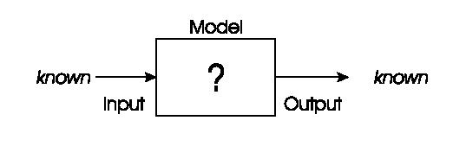
Problem types 2: Modelling
We have corresponding sets of inputs & outputs and we seek model that delivers correct output for every known input
E.g.
Evolutionary machine learning

Slide 11
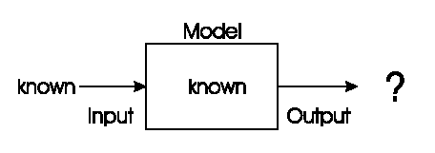
Problem type 3: Simulation
We have a given model and wish to know the outputs that arise under different input conditions
Often used to answer “what-if” questions in evolving dynamic environments
e.g. Use models to optimise strategies and policies

Slide 12
Basis of EC (or evolution in general)
A population of individuals exists in an environment with limited resources
Competition for those resources causes selection of those fitter individuals that are better adapted to the environment
(survival for the fittest)
These individuals act as seeds for the generation of new individuals through recombination and mutation
The new individuals have their fitness evaluated and compete (possibly also with parents) for survival.
Over time Natural selection causes a rise in the fitness of the population

Slide 13
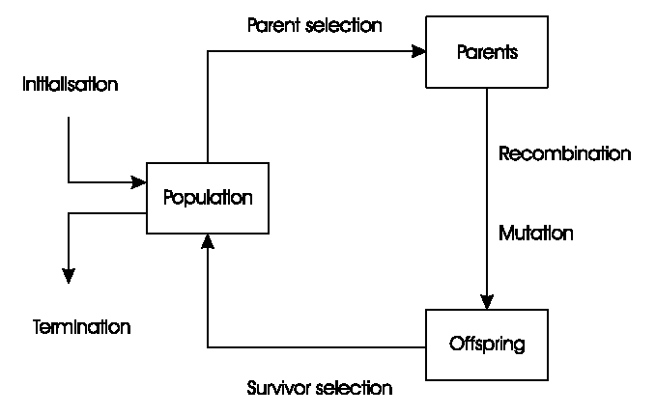
General Scheme of EAs

Slide 14
General Framework of EC
Generate Initial Population
Fitness Function
Evaluate Fitness
Termination Condition?
Yes
Best Individual
No
Select Parents
Crossover, Mutation
Generate New Offspring

Slide 15
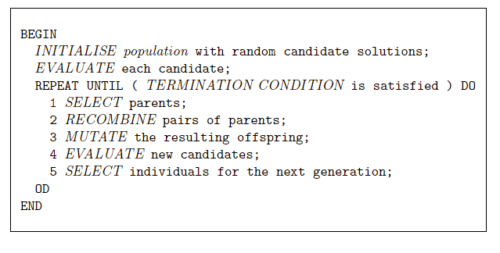
Pseudo-code for typical EA

Slide 16
Population
Holds (representations of) possible solutions
Usually has a fixed size and is a multiset of genotypes
Some sophisticated EAs also assert a spatial structure on the population e.g.,a grid.(see gray coding)
Selection operators usually take whole population into account i.e., reproductive probabilities are relative to current generation
Diversity of a population refers to the number of different fitnesses / phenotypes / genotypes present (note not the same thing)

Slide 17
Representations
Candidate solutions (individuals) exist in phenotype space
They are encoded in chromosomes, which exist in genotype space
  Encoding : phenotype=> genotype (not necessarily one to one)
  Decoding : genotype=> phenotype (must be one to one)
Chromosomes contain genes, which are in (usually fixed) positions called loci (singular -. locus) and have a value (allele)
In order to find the global optimum, every feasible solution must be represented in genotype space

Slide 18
Encoding
-“Coding of the population for evolution process”.
*Binary Encoding:
In binary encoding, every chromosome is a
string of bits - 0 or 1.
Chromosome A
101100101100101011100101
Chromosome B
111111100000110000011111
*Permutation Encoding:
In permutation encoding, every chromosome is a string of numbers that represent a position in a sequence.
Chromosome A
1 5 3 2 6 4 7 9 8
Chromosome B
8 5 6 7 2 3 1 4 9

Slide 19
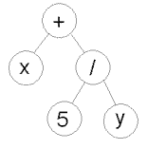
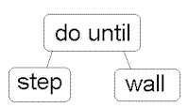
Encoding cont’d
Values can be anything connected to problem.
*Value Encoding:
Chromosome A
1.2324 5.3243 0.4556 2.3293 2.4545
*Tree Encoding:
Chromosome B
ABDJEIFJDHDIERJFDLDFLFEGT
Chromosome C
(back), (back), (right), (forward), (left)
Chromosome A
Chromosome B
In this, every chromosome is a tree of some function or command in prog. Language and variables
( + x ( / 5 y ) )
( do_until step wall )

Slide 20
Evaluation (Fitness) Function
Represents the requirements that the population should adapt to
a.k.a. quality function or objective function – a quality measure
Assigns a single real-valued fitness to each phenotype which forms the basis for selection
  So the more discrimination (different values) the better
Typically we talk about fitness being maximised
  Some problems may be best posed as minimisation problems, but conversion is trivial

Slide 21


Objective fn formulation - example
  maximize
  subject to

Slide 22
Parent Selection Mechanism
Assigns variable probabilities of individuals acting as parents depending on their fitnesses
Usually probabilistic
  high quality solutions more likely to become parents than low quality
  but not guaranteed
  even worst in current population usually has non-zero probability of becoming a parent
This stochastic nature can aid escape from local optima

Slide 23
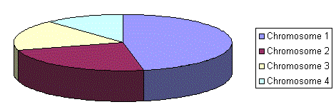
1.Roulette Wheel Selection/stochastic universal sampling
-The size of the section in the roulete wheel is proportional to the value of the fitness function of every chromosome - the bigger the value is, the larger the section is.
-N equally spaced pointers are placed around the roulette wheel and the chromosomes where it stops is selected.

Slide 24
2.Tournament selection
Select two strings at random and place the best in the intermediate population
Tournament size may vary.

Slide 25
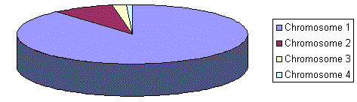
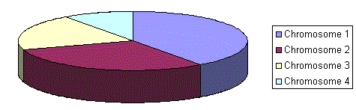
3.Rank based selection
Ranks the population first and then every chromosome
receives fitness value determined by this ranking. The worst
will have the fitness 1, the second worst 2 etc. and the best
will have fitness N (number of chromosomes in population).
Situation before ranking (graph of fitnesses)
Situation after ranking (graph of order numbers)

Slide 26
Variation Operators
Role is to generate new candidate solutions
Usually divided into two types according to their arity (number of inputs):
  Arity 1 : mutation operators
  Arity >1 : Recombination operators
  Arity = 2 typically called crossover
There has been much debate about relative importance of recombination and mutation
  Nowadays most EAs use both
  Choice of particular variation operators is representation dependant

Slide 27
Mutation
Acts on one genotype and delivers another
Element of randomness is essential and differentiates it from other unary heuristic operators
Importance ascribed depends on representation and dialect:
  Binary GAs – background operator responsible for preserving and introducing diversity
  EP for FSM’s/ continuous variables – only search operator
  GP – hardly used
May guarantee connectedness of search space and hence convergence proofs

Slide 28
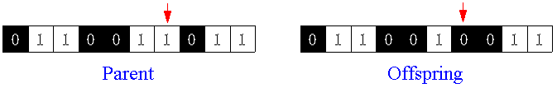
Mutation examples
Bit inversion
order changing
Gaussian pertubation
(1 2 3 4 5 6 8 9 7) => (1 8 3 4 5 6 2 9 7)
σi’ = σi • (1 + α • N(0,1))

Slide 29
Recombination
Merges information from parents into offspring
Choice of what information to merge is stochastic
Most offspring may be worse, or the same as the parents
Hope is that some are better by combining elements of genotypes that lead to good traits

Slide 30
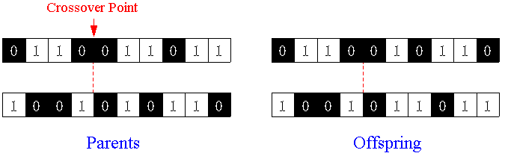
1 - point crossover
A crossover point is selected at random and parts of the two parent chromosomes are swapped to create two offspring with a probability which is called crossover rate.

Slide 31
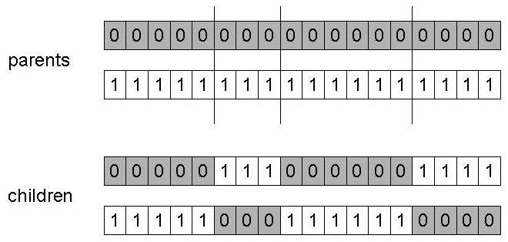
n-point crossover
Choose n random crossover points
Split along those points
Glue parts, alternating between parents
Generalisation of 1 point

Slide 32
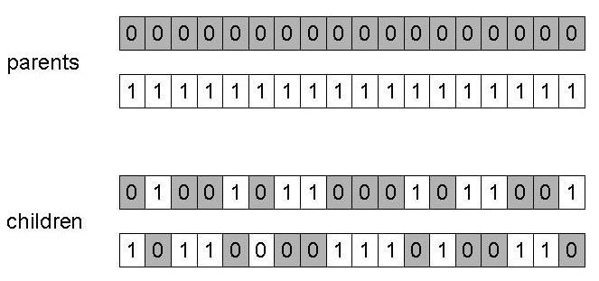
Uniform crossover
Assign 'heads' to one parent, 'tails' to the other
Flip a coin for each gene of the first child
Make an inverse copy of the gene for the second child

Slide 33
Remark - Crossover OR mutation?
Exploration: Discovering promising areas in the search space, i.e. gaining information on the problem
Exploitation: Optimising within a promising area, i.e. using information
There is co-operation AND competition between them
Crossover is explorative, it makes a big jump to an area somewhere “in between” two (parent) areas
Mutation is exploitative, it creates random small diversions, thereby staying near (in the area of ) the parent

Slide 34
Survivor Selection
Also called replacement
Most EAs use fixed population size ,so need a way of going from (parents + offspring) to next generation
Often deterministic
  Fitness based : e.g., (rank parents+offspring) and take best (see also steady state )(u+v)
  Age based: make as many offspring as parents and delete all parents (u,u)
Sometimes do combination (elitism)

Slide 35
Initialisation / Termination
Initialisation usually done at random,
  Need to ensure even spread and mixture of possible allele values
  Can include existing solutions, or use problem-specific heuristics, to “seed” the population
Termination condition checked every generation
  Reaching some (known/hoped for) fitness
  Reaching some maximum allowed number of generations
  Reaching some minimum level of diversity
  Reaching some specified number of generations without fitness improvement

Slide 36
Summary – when working with EA’s
Design a representation
Design a way of mapping a genotype to a phenotype
Design a way of evaluating an individual
Design suitable mutation operator(s)
Design suitable recombination operator(s)
Decide how to select individuals to be parents
Decide how to select individuals for the next generation (management of population)
Decide how to start: initialization method
Decide how to stop: termination criterion

Slide 37
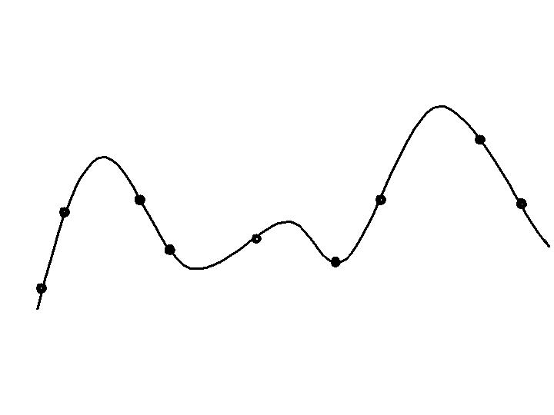
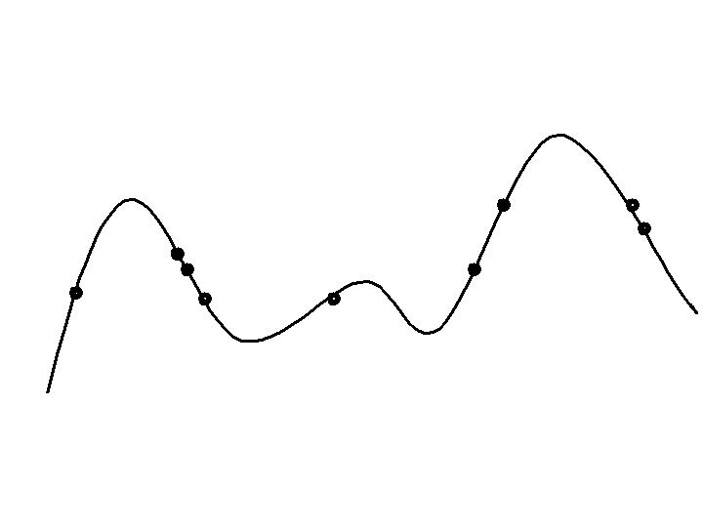
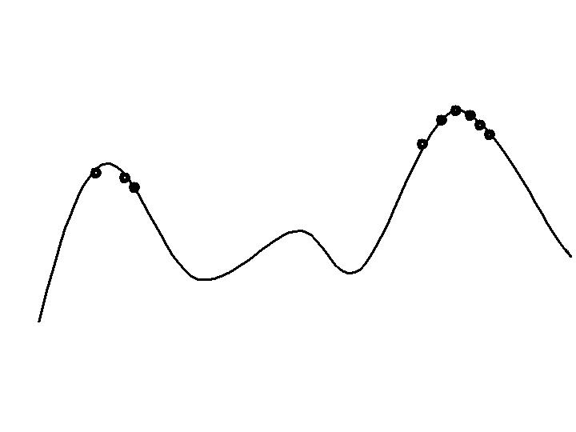
Typical behaviour of an EA
Phases in optimising on a 1-dimensional fitness landscape
Early phase:
random population distribution
Mid-phase:
population arranged around/on hills
Late phase:
population concentrated on high hills

Slide 38
Advantages of EC
No presumptions w.r.t. problem space
Widely applicable
Low development & application costs
Easy to incorporate other methods
Solutions are interpretable (unlike NN)
Can be run interactively, accommodate user proposed solutions
Provide many alternative solutions

Slide 39
Disadvantages of EC
No guarantee for optimal solution within finite time
Weak theoretical basis
May need parameter tuning
Often computationally expensive, i.e. slow

Slide 40
EA Paradigms
Historically different flavours of EAs have been associated with different representations
  Binary strings : Genetic Algorithms
  Real-valued vectors : Evolution Strategies
  Finite state Machines: Evolutionary Programming
  LISP trees: Genetic Programming

Slide 41
GA Quick Overview
Developed: USA in the 1970’s
Early names: J. Holland, K. DeJong, D. Goldberg
Typically applied to:
  discrete optimization
Attributed features:
  not too fast
  good heuristic for combinatorial problems
Special Features:
  Traditionally emphasizes combining information from good parents (crossover)
  many variants, e.g., reproduction models, operators

Slide 42
SGA technical summary tableau
Representation | Binary strings
Recombination | N-point or uniform
Mutation | Bitwise bit-flipping with fixed probability
Parent selection | Fitness-Proportionate
Survivor selection | All children replace parents
Speciality | Emphasis on crossover

Slide 43
ES quick overview
Developed: Germany in the 1970’s
Early names: I. Rechenberg, H.-P. Schwefel
Typically applied to:
  numerical optimisation
Attributed features:
  fast
  good optimizer for real-valued optimisation
  relatively much theory
Special:
  self-adaptation of (mutation) parameters standard

Slide 44
ES technical summary tableau
Representation | Real-valued vectors
Recombination | Discrete or intermediary
Mutation | Gaussian perturbation
Parent selection | Uniform random
Survivor selection | (μ,λ) or (μ+λ)
Specialty | Self-adaptation of mutation step sizes

Slide 45
EP quick overview
Developed: USA in the 1960’s
Early names: D. Fogel
Typically applied to:
  traditional EP: machine learning tasks by finite state machines
  contemporary EP: (numerical) optimization
Attributed features:
  very open framework: any representation and mutation op’s OK
  crossbred with ES (contemporary EP)
  consequently: hard to say what “standard” EP is
Special:
  no recombination
  self-adaptation of parameters standard (contemporary EP)

Slide 46
EP technical summary tableau
Representation | Real-valued vectors
Recombination | None
Mutation | Gaussian perturbation
Parent selection | Deterministic
Survivor selection | Probabilistic (μ+μ)
Specialty | Self-adaptation of mutation step sizes (in meta-EP)

Slide 47
GP quick overview
Developed: USA in the 1990’s
Early names: J. Koza
Typically applied to:
  machine learning tasks (prediction, classification…)
Attributed features:
  competes with neural nets and alike
  needs huge populations (thousands)
  slow
Special:
  non-linear chromosomes: trees, graphs
  mutation possible but not necessary (disputed!)

Slide 48
GP technical summary tableau
Representation | Tree structures
Recombination | Exchange of subtrees
Mutation | Random change in trees
Parent selection | Fitness proportional
Survivor selection | Generational replacement

Slide 49
Remarks and Future scope
Foundation concepts have been presented in this lecture however, in the future:
  Concepts of parameters control – choice of values, self adapting values…….
  Comparison with particle based algorithms for similarities and differences.
  Use of hybrid EA’S (memetic algorithms)

Slide 50
Example: the 8 queens problem
Place 8 queens on an 8x8 chessboard in
such a way that they cannot check each other

Slide 51
The 8 queens problem: Representation
Phenotype:
a board configuration
Genotype:
a permutation of
the numbers 1 - 8
Obvious mapping
1
3
5
2
6
4
7
8

Slide 52
8 Queens Problem: Fitness evaluation
Penalty of one queen:
the number of queens she can check.
Penalty of a configuration:
the sum of the penalties of all queens.
Note: penalty is to be minimized
Fitness of a configuration:
inverse penalty to be maximized

Slide 53
The 8 queens problem: Mutation
Small variation in one permutation, e.g.:
swapping values of two randomly chosen positions,
1
3
5
2
6
4
7
8
1
3
7
2
6
4
5
8

Slide 54
The 8 queens problem: Recombination
Combining two permutations into two new permutations:
choose random crossover point
copy first parts into children
create second part by inserting values from other parent:
  in the order they appear there
  beginning after crossover point
  skipping values already in child
1
3
5
2
6
4
7
8
1
3
5
4
2
8
7
6
8
7
6
5
4
3
2
1
8
7
6
2
4
1
3
5

Slide 55
The 8 queens problem: Selection
Parent selection:
  Pick 5 parents and take best two to undergo crossover
Survivor selection (replacement)
  When inserting a new child into the population, choose an existing member to replace by:
  sorting the whole population by decreasing fitness
  enumerating this list from high to low
  replacing the first with a fitness lower than the given child

Slide 56
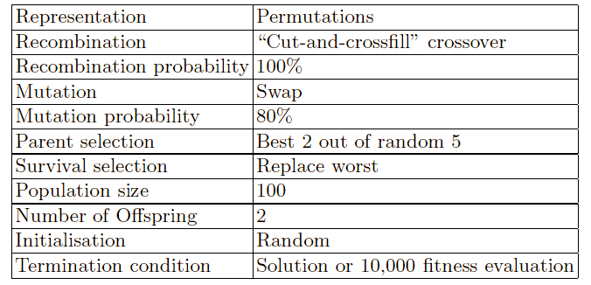
8 Queens Problem: summary
Note that is is only one possible
set of choices of operators and parameters

Slide 57

2.Demonstration: magic square
Software by M. Herdy, TU Berlin
Interesting parameters:
  Step1: small mutation, slow & hits the optimum
  Step10: large mutation, fast & misses (“jumps over” optimum)
  Mstep: mutation step size modified on-line, fast & hits optimum
Start: double-click on icon below
Exit: click on TUBerlin logo (top-right)

Slide 58
Conclusion
Differences in EA paradigms are largely irrelevant, best strategy:
  choose representation to suit problem
  choose variation operators to suit representation
EA areas of application are growing immensely due to their flexibility
Detailed “guiding principles” required on when best to apply a given algorithm – no free lunch theorem.

Slide 59
References
[1] Darrell whitley, An overview of evolutionary algorithms: Practical issues and common pitfalls (2001)
http://citeseerx.ist.psu.edu/viewdoc/summary?doi=10.1.1.12.5095
[2] .D.B.Fogel, THEORY OF MODERN HEURISTIC. OPTIMIZATION
media.wiley.com/product_data/excerpt/16/04714571/0471457116.pdf
[3] Thomas Back, Frank Hoffmeister, Hans--paul Schwefel, A survey of evolution strategies (1991) Proceedings of the Fourth International Conference on Genetic Algorithms
http://citeseerx.ist.psu.edu/viewdoc/summary?doi=10.1.1.42.3375
[4] A.E Elben and J.E Smith, Introduction to Evolutionary computation, http://www.cs.vu.nl/~gusz/ecbook/ecbook-illustrations.html
[5] http://neo.lcc.uma.es/opticomm/introea.html
[6 ] http://www.geatbx.com/docu/algindex.html
[7] George F Luger, Artificial intelligence - structures abd strategies for complex problem solving, 5th edition pg 507-41

Slide 60
End – Thank you
Questions and Comments

